Slide 1


Turas Analytics Engine

Slide 2
WHAT IS TURAS?
01
Your Research Should Work Harder
Good Data, Limited Life
You commission research and get a deck that answers the questions you asked at the time.
New Questions, Old Process
When a new question surfaces, someone has to reopen the dataset and rebuild the analysis. That takes time and money.
There Is a Better Way
Most research ends up as a presentation rather than a resource. Turas changes that.

Slide 3
WHY YOU CAN TRUST IT
02
What Turas Delivers
Interactive Analytics
An interactive resource your team can explore, share, and return to
Rigorous Statistics
Statistical analysis run directly from your data with full transparency
Permanent Record
One dataset. One report. Useful for as long as the data is relevant
Pay Per Project
No subscription fees. No licence costs. You pay per project
One dataset. One report. Useful for as long as the data is relevant.

Slide 4
WHY HTML REPORTS ARE THE FUTURE
03
Serious Statistical Foundations
━━━
Built on R
The open-source statistical environment used by national statistics offices, central banks, and universities worldwide.
━━━
Fully Transparent
Every calculation is inspectable. Methods can be examined and verified. Results trace back to underlying tables.
━━━
No Black Boxes
When a finding is challenged, you have a clean, traceable analytical record to stand behind.
Every result traces directly back to the underlying tables.
Open, transparent, and fully auditable

Slide 5
WHY HTML REPORTS ARE THE FUTURE
04
Professional Oversight
Turas is not a self-service tool.
━━━
SAMRA Accredited
The Research LampPost is a member of the Southern African Marketing Research Association. Duncan Brett is SAMRA-accredited with 30+ years in quantitative market research.
━━━
Guided End-to-End
Every project is guided from data preparation through to final output. The right methods are applied, data is structured correctly, and results are interpreted responsibly.
30+ years of quantitative market research expertise behind every project

Slide 6
WHY HTML REPORTS ARE THE FUTURE
05
Your Data Stays With You
━━━
No Cloud Upload
Your dataset is never uploaded to a cloud platform or shared with a third party
━━━
Controlled Environment
All analysis runs on our own hardware in a secure, controlled environment
━━━
Immutable Record
The delivered report is finalised and self-contained — it cannot be altered after the fact
A stable record of exactly what the data showed at the time of analysis.

Slide 7
WHY HTML REPORTS ARE THE FUTURE
06
Fast, Consistent, Dependable
1 Day
Preliminary output after fieldwork closes
Weeks
Traditional analysis timeline
Built-in Consistency
Same methods, every time. For tracking studies, results stay comparable across waves.
Controlled computational environment. Reproducible results. Every time.

Slide 8
WHY HTML REPORTS ARE THE FUTURE
07
Interactive Report, Not Static
Browser-Based
Runs in any modern browser. Nothing to install, no subscription, no licence to manage.
Single Source of Truth
Browse all tables, switch between table and chart views, cut by any segment — without waiting for the analyst.
Excel Export
Tables can be exported to Excel at any point, fitting into existing workflows.
Zero installation | Zero subscriptions | Zero licence management

Slide 9
WHY HTML REPORTS ARE THE FUTURE
08
From Exploration to Presentation
1
2
3
Explore
Browse tables, switch views, cut by any segment in the interactive report
Pin
Capture key findings with charts, commentary and images using pinned views
Present
Export pinned views to PowerPoint or PDF for stakeholder presentation
→
→
One environment for both exploration and presentation — no tool-switching required.

Slide 10
WHY HTML REPORTS ARE THE FUTURE
09
What Turas Can Analyse
Specialist analytical modules, all delivered within the same interactive report.
Tabs
Automated crosstabs with significance testing
Tracker
Multi-wave trend analysis across waves
Key Driver
Strongest factors driving business outcomes
Key Driver (Cat.)
Regression for categorical outcomes
Segment
Statistical clustering for customer groups
Conjoint
Choice modelling with market simulator
MaxDiff
Precise preference rankings
Pricing
Van Westendorp and Gabor-Granger models
Weighting
Target population representation
Confidence
Rigorous validity testing
Multiple modules can be combined into a single report.

Slide 11
WHY HTML REPORTS ARE THE FUTURE
10
What We Can Help With
━━━
Questionnaire Design
Structuring questions to produce clean, analysable data
━━━
Analytical Planning
Choosing the right methods and structuring the approach
━━━
Data Preparation
Cleaning, coding, and preparing data for rigorous analysis
━━━
Interpretation
Making sense of results and building a clear narrative
For most projects we also prepare an initial set of pinned views, giving your team a ready-made starting point.

Slide 12
WHY HTML REPORTS ARE THE FUTURE
11
See It In Action
The most effective way to understand Turas is a live demonstration.
We can walk through a real dataset and show how survey data becomes a working analytical resource — from raw data to interactive report.
Request a Demo

Slide 13
Sample Slides from Turas
Demonstrating report pin outputs

Slide 15


R
G
B
3
3
3
50
51
103
204
153
0
229
107
51

Slide 16
What Turas Can Do
Analysis Modules
Tabs
Tracker
Key Driver
Key Driver (Cat.)
Automated crosstabs with frequency, column %, row %, significance testing & weighting.
Multi-wave trend analysis with significance testing and question mapping across waves.
Identifies factors with the strongest statistical relationship to key business outcomes.
Regression methods for categorical outcomes — purchase decisions, segments, or tiers.
Segment
Conjoint
MaxDiff
Pricing
Statistical clustering to discover natural customer groups beyond broad averages.
Discrete choice modelling with an Excel-based interactive market simulator.
Precise preference rankings from balanced best/worst item sets.
Price sensitivity analysis using Van Westendorp & Gabor-Granger models.
Current operational modules (with more in development)
Supporting Modules
Weighting — ensures data represents your target population | Confidence — rigorous validity testing beyond standard significance flags

Slide 17
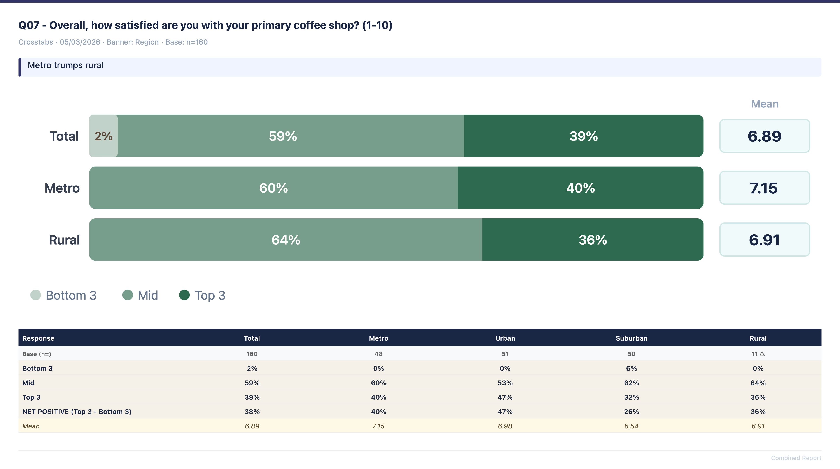
Overall satisfaction

Slide 18
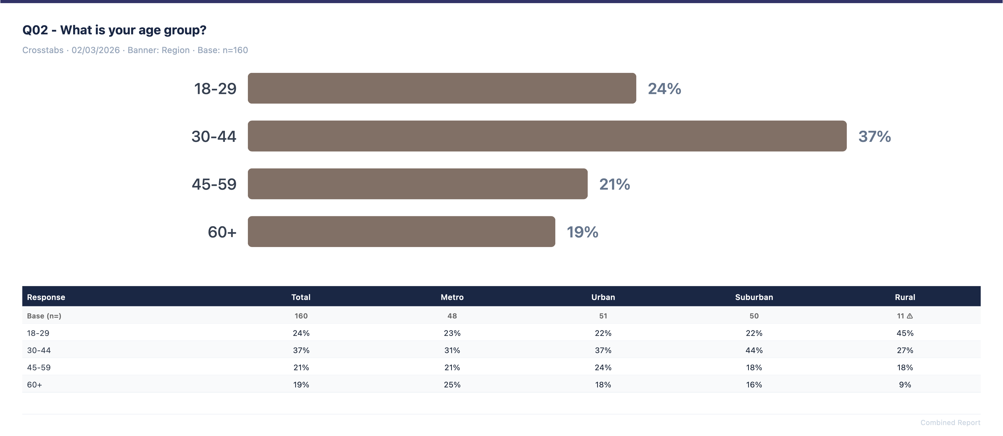
Age by region

Slide 19
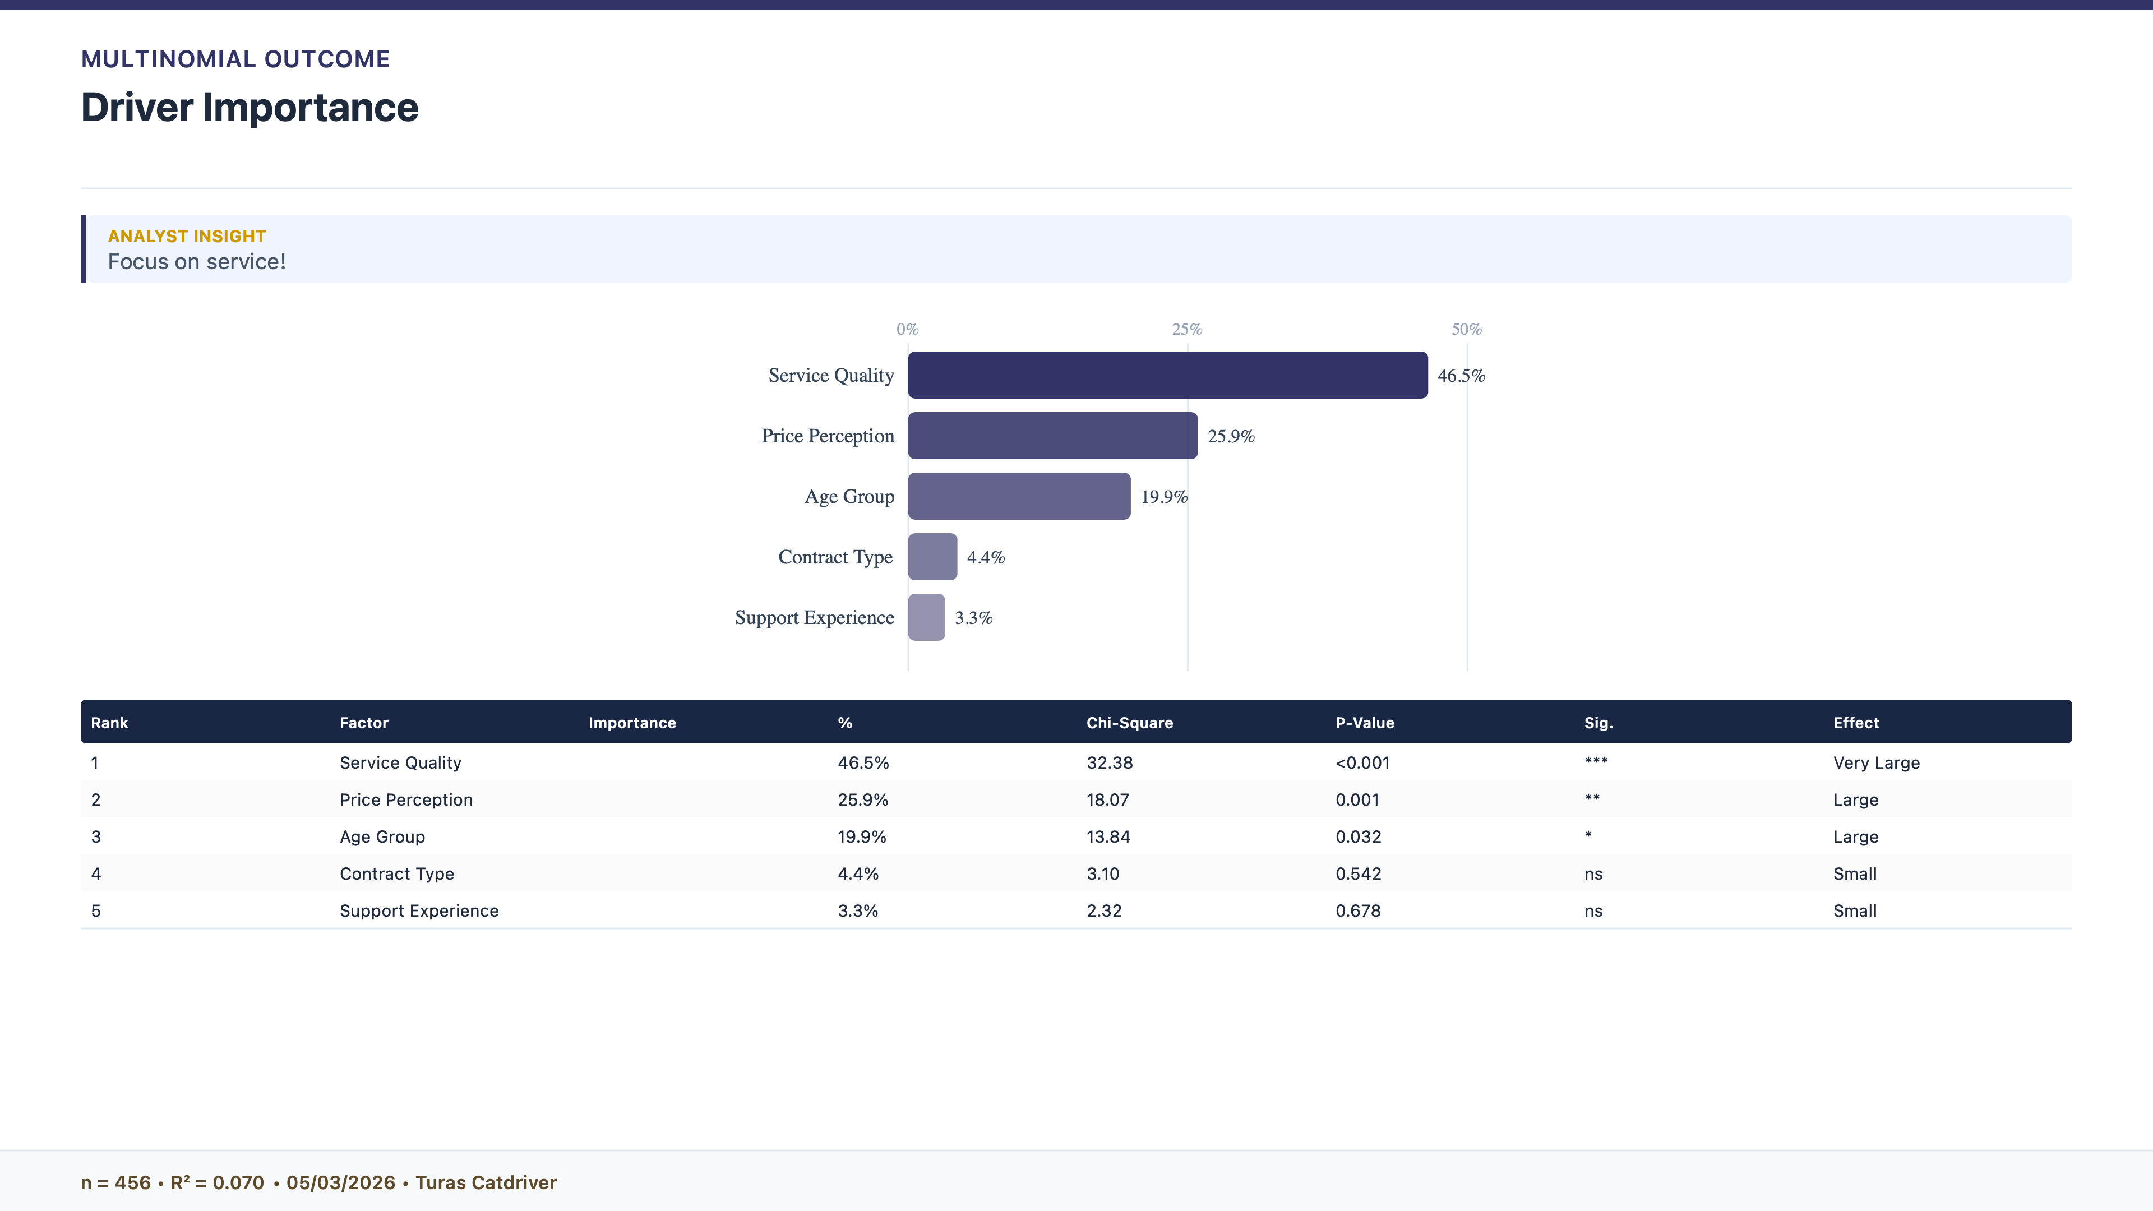
What is driving satisfaction

Slide 20
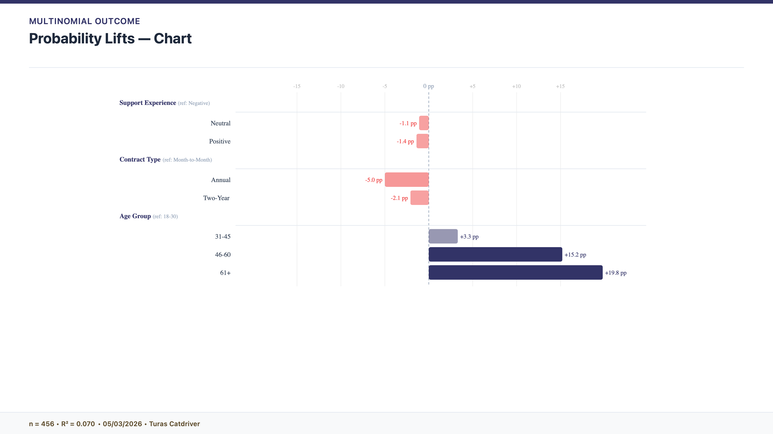
The older you are the higher the chances of satisfaction

Slide 21
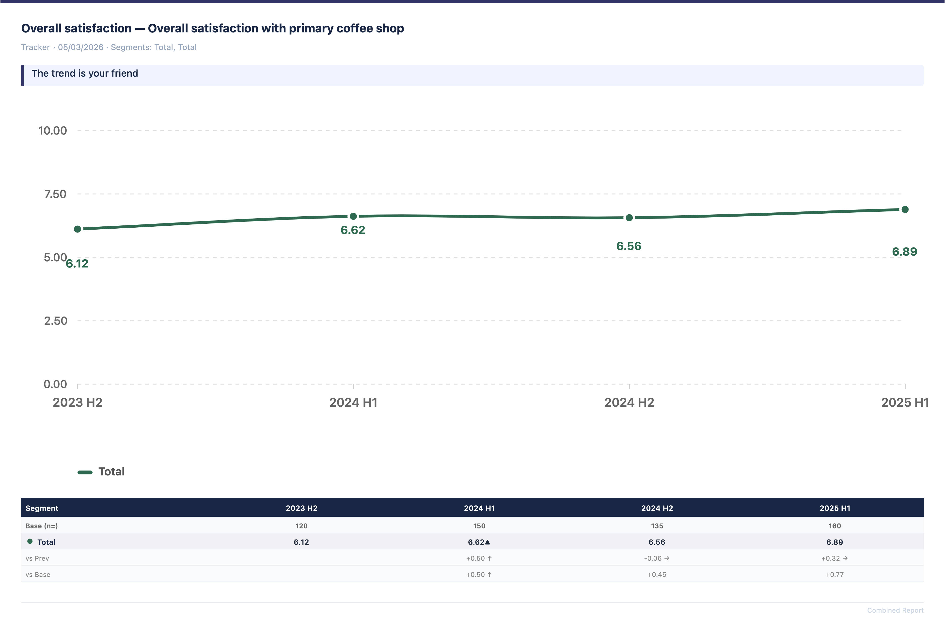
Cross wave comparison

Slide 22
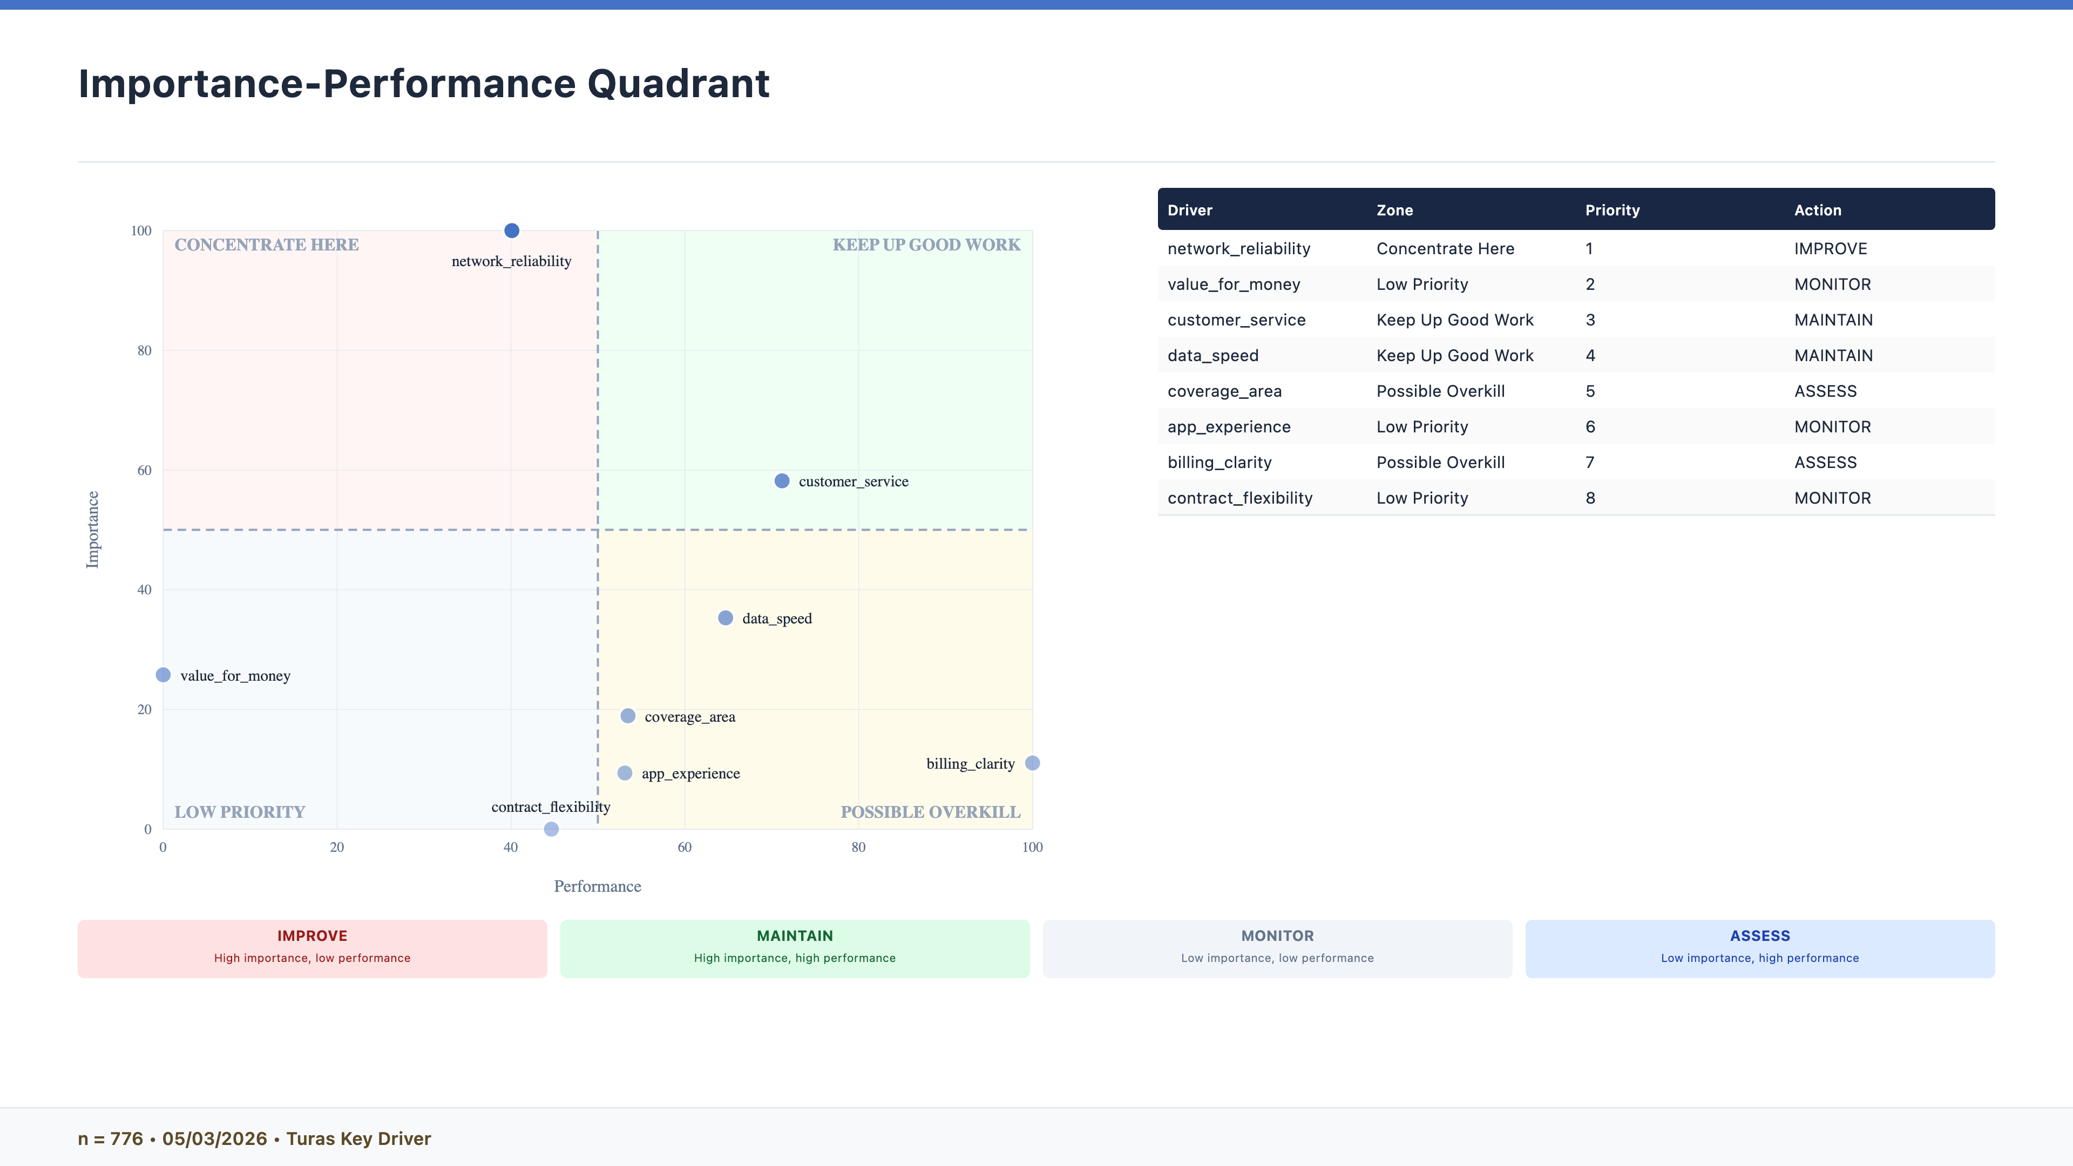
Importance performance maps

Slide 23
Thank You
Reproducible research analysis, delivered.

